Slide 1



Composition

Slide 2
(3) Composition
docker
compose
(2) Containerization
(1) Microservice

Slide 3
The Cloud Native Stack
Cloud Native Application Platform
Classical Applications
Cloud Native App
Cluster Operating System
Cluster Orchestrator
Applications
Cluster Scheduler
Container
Cluster Virtualization
Resources

Slide 4
The Cloud Native Stack
Cloud Native Application Platform
Classical Applications
Cloud Native App
Cluster Operating System
Cluster Orchestrator
Applications
Cluster Scheduler
Container
Cluster Virtualization
Resources

Slide 5
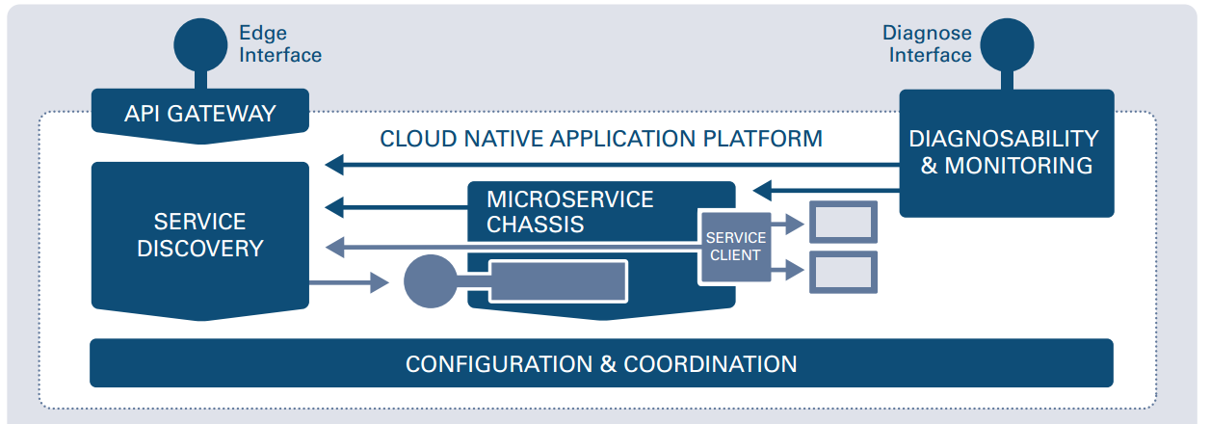
How to provide cluster-wide configuration and consensus?
How to access endpoints from the outside?
How to detect and resolve operational anomalies?
How to expose and find endpoints?
How to call other endpoints resilient and responsive?
How to execute an ops component?

Slide 6
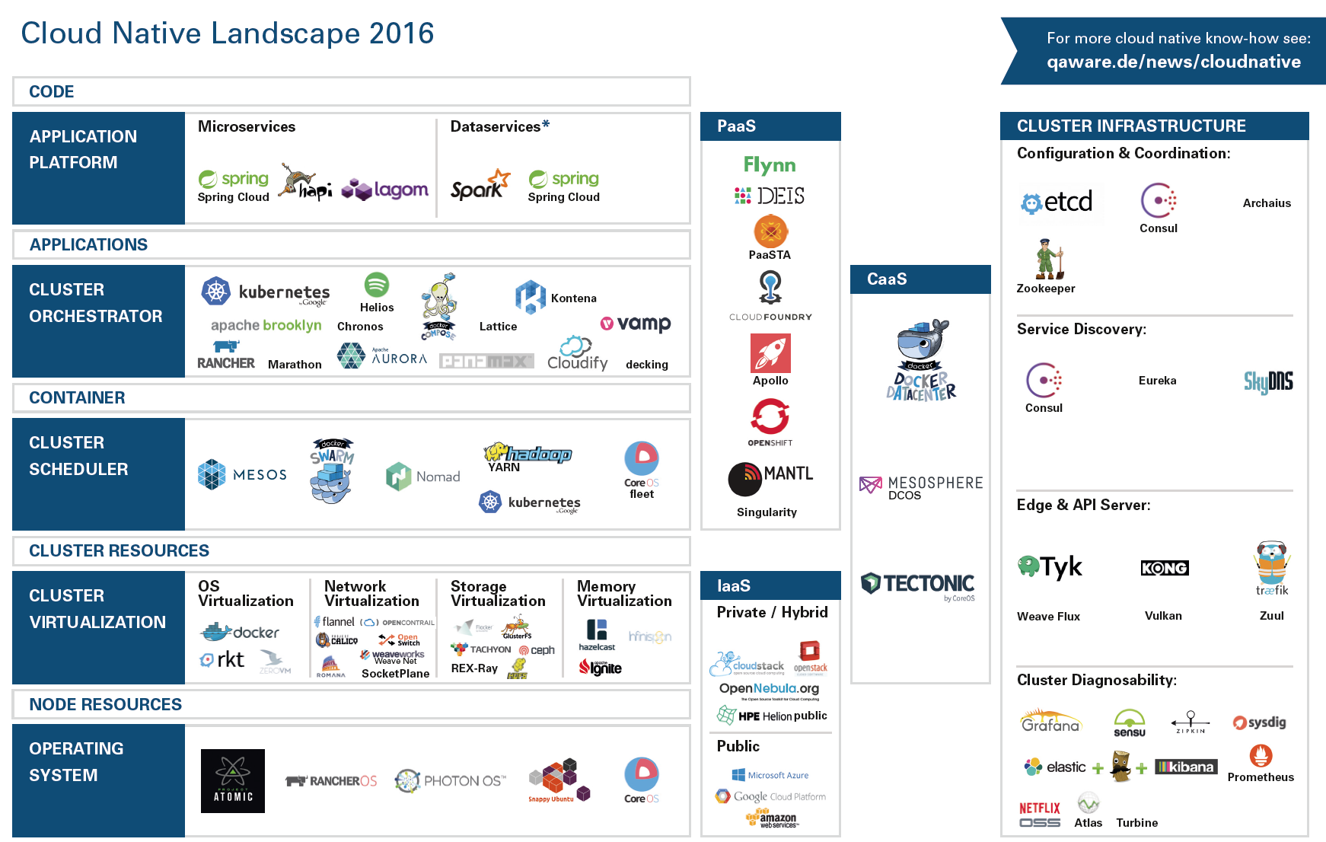

Slide 7
The Cloud Native Stack
Cloud Native Application Platform
Classical Applications
Cloud Native App
Cluster Operating System
Cluster Orchestrator
Applications
Cluster Scheduler
Container
Cluster Virtualization
Resources

Slide 8
Ops Components can also be carved out of Classical Software.
Sample:
Ops component
NGINX
Ops component but has to be integrated into the cloud infrastructure
Replace with cloud infrastructure
Tomcat
Ops component. Possible modifications:
Configure used endpoints by environment variables
Remove cross-instance state
MySQL
Single instance
Use a cluster-version like Galera or Vitess
Operate outside of the cloud

Slide 9
The Cloud Native Stack
Cloud Native Application Platform
Classical Applications
Cloud Native App
Cluster Operating System
Cluster Orchestrator
Applications
Cluster Scheduler
Container
Cluster Virtualization
Resources

Slide 10
Compose: Building and Wiring Multiple Containers Locally.
consul:
image: gliderlabs/consul-server:0.6
command: "-data-dir /tmp/consul -bootstrap-expect 1 -server -ui -node=consul-server"
environment:
- GOMAXPROCS=10
ports:
- "8300:8300" #server - Server RPC address. Default 8300.
- "8500:8500" #http - The HTTP API, -1 to disable. Default 8500.
- "8600:8600/udp" #dns - The DNS server, -1 to disable. Default 8600.
zwitscher-chuck:
build: ../../services/zwitscher-app-chuck
ports:
- "12340:12340" #chuck REST service
links:
- consul
docker-compose -f compose.yml build
docker-compose -f compose.yml up –d
docker-compose -f compose.yml ps
https://docs.docker.com/compose/compose-file
https://docs.docker.com/compose/reference

